Slide 1
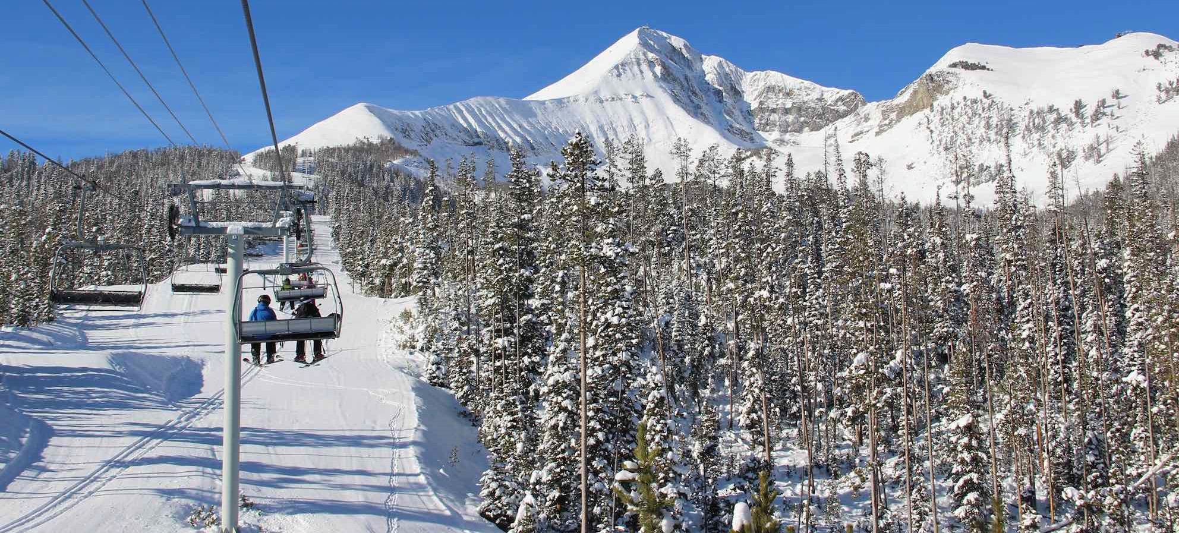
Report of Guided Capstone Project One
BIG MOUNTAIN RESORT, MONTANA

Slide 2
Problem Identification
What ticket pricing strategy can help Big Mountain by the end of the current financial year to recover the new equipment investment and operating costa and to increase the profit without undermining the ticket price?
1
Context
4
Constraints within solution space
Big Mountain Resort is a ski resort located in Montana offers spectacular ski services to skiers and riders of all levels with professional configurations. Recently, Big Mountain Resort has installed an additional chair lift. To recover the investment and increase the profit , the company wants to find a new pricing strategy with a good sense of how important some facilities are compared to others by cutting costs without undermining the ticket price or setting an even higher ticket price.
There is a risk that some visitors will not choose Big Mountain Resort if the ticket price is increased.
5
Stakeholders to provide key insight
2
Criteria for success
Director of Operations, Jimmy Blackburn
Database Manager, Alesha Eisen
The new ticket pricing will improve the profit without reducing the price.
3
Scope of solution space
6
Key data sources
The new pricing strategy will not be developed based on the average pressure, but it must be with a good sense of how important some facilities are compared to others.
A CSV file provided by the database manager contains the information from 330 resorts in the US that can be considered part of the same market share. The critical features include: Number of chairlifts, Number of runs, skiable area, days open last year, annual snowfall inches, weekday&weekend ticket price.

Slide 3
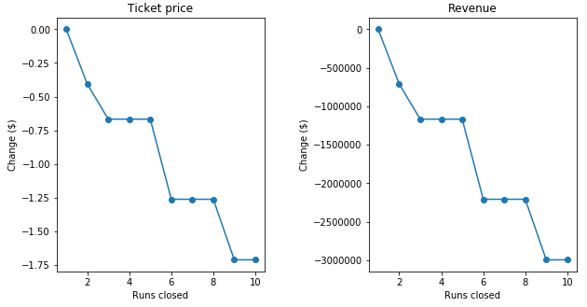
Recommendation and key findings
4 options have been studied and compared:
Scenario 1:
As shown in the figure below, the model says closing one run makes no difference. Closing 2 and 3 successively reduces support for ticket price and so revenue. If Big Mountain closes down 3 runs, it seems they may as well close down 4 or 5 as there's no further loss in ticket price. Increasing the closures down to 6 or more leads to a large drop.
Scenario 2:
In this scenario, Big Mountain is adding a run, increasing the vertical drop by 150 feet, and installing an additional chair lift.
The outcome of the model predicts that this scenario increases support for ticket price by $8.46. Over the season, the revenue could be expected to amount to $14811594
Scenario 3:
In this scenario, Big Mountain is adding 2 acres of snow making. The model predicts that this scenario increases support for ticket price by $9.75. Over the season, the revenue could be expected to amount to $17068841
Scenario 4:
This scenario calls for increasing the longest run by 0.2 miles and guaranteeing its snow coverage by adding 4 acres of snow making capability. The results predicted by the model show that there is no price and revenue changes.

Slide 4
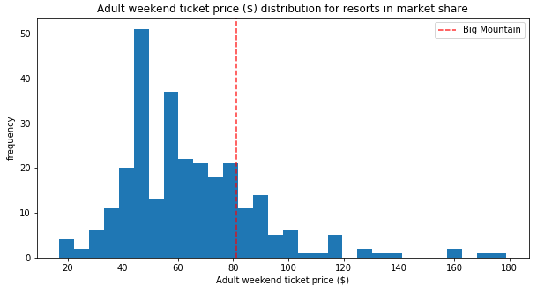
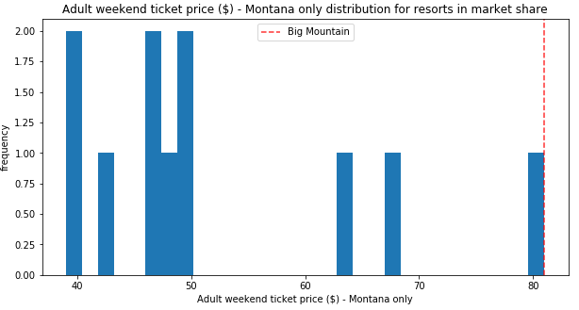
Modeling results and analysis
Where Big Mountain sits overall amongst all resorts for price and for just other resorts in Montana.

Slide 5
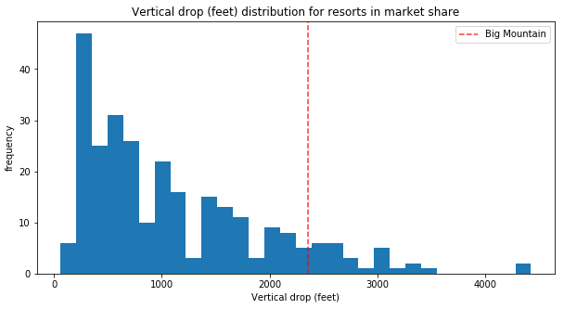
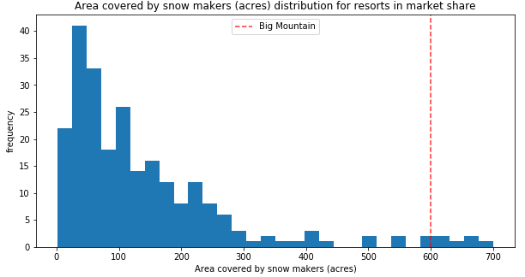
Modeling results and analysis
Where Big Mountain sits overall amongst all resorts for price and for just other resorts in Montana.

Slide 6
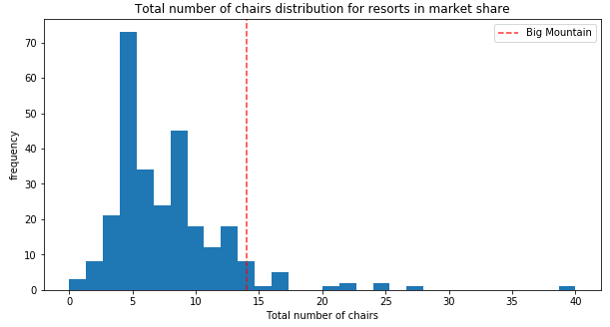
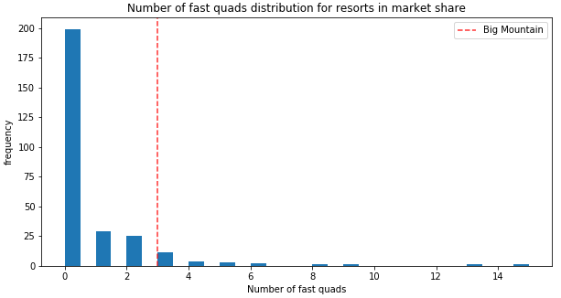
Modeling results and analysis
Where Big Mountain sits overall amongst all resorts for price and for just other resorts in Montana.

Slide 7
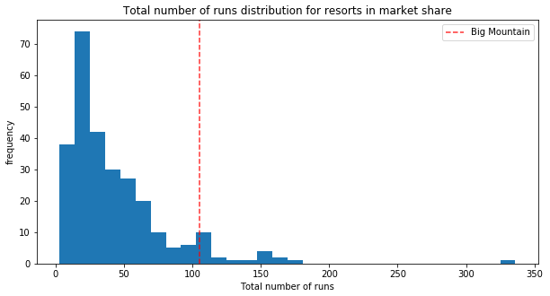
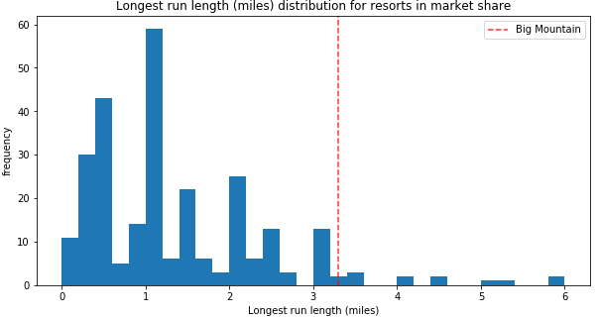
Modeling results and analysis
Where Big Mountain sits overall amongst all resorts for price and for just other resorts in Montana.

Slide 8
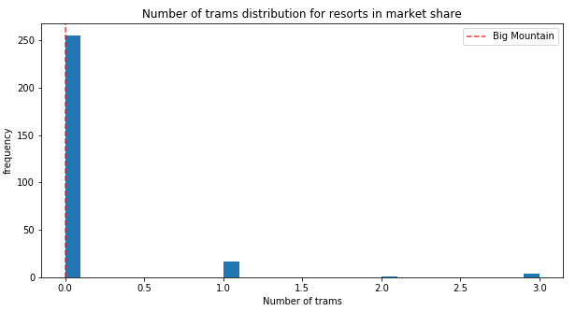
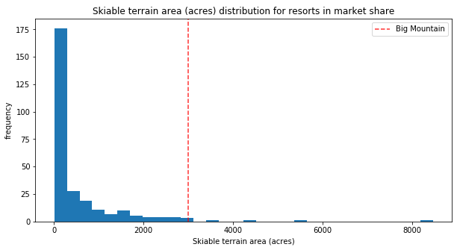
Modeling results and analysis
Where Big Mountain sits overall amongst all resorts for price and for just other resorts in Montana.

Slide 9
Summary and conclusion
Big mountain currently charge $81 for adult at weekend
The model suggests the best scenario is to add 2 acres of snow making
The results show that the increase supports for ticket price change by $9.75. Over the season, the revenue could be expected to amount to $17068841

